Slide 1

AI
Image Generation
CSE 542
Supervisor:
Prof. Zhenhua Liu
Presenters (Group ID 1):
Pandre Vamshi (115077003)
Prajjawal Agarwal (115134849)
Shreejay V. Jahagirdar (115071683)

Slide 2
Table of contents
01
02
03
04
05
Background
Opportunities
Pros & Cons
Application Scenarios
Discussions

Slide 3
Background

Slide 4
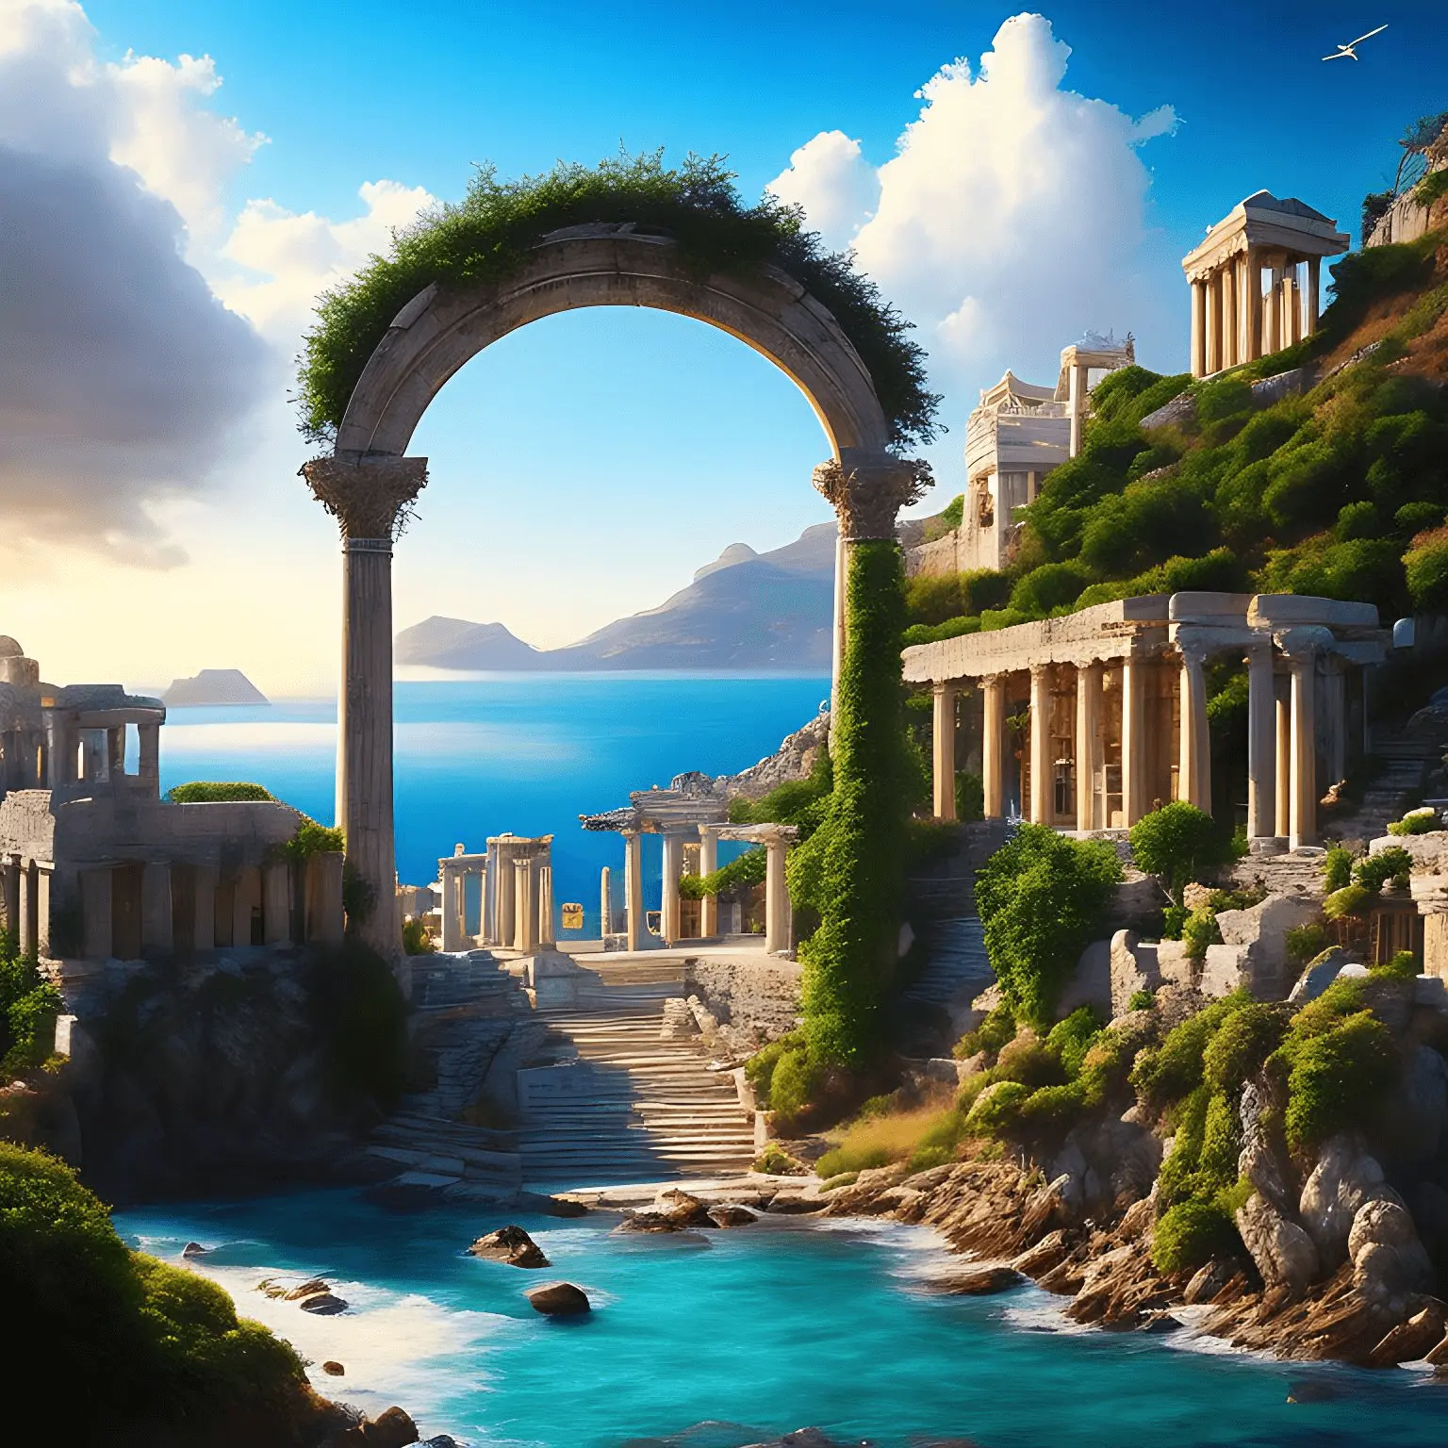
Overview
What is AI Image Generation
AI image generation is a cutting-edge technology that uses artificial intelligence to produce or manipulate images with remarkable detail and realism. With recent advancements in this field, computers can now generate images that are almost indistinguishable from those created by humans.
AI image generators use artificial neural networks to create images from text input. They blend styles, concepts, and attributes to produce original and realistic visuals. This is made possible through Generative AI, a subset of artificial intelligence focused on content creation. The generators are trained on large datasets of images, allowing them to learn and create new images with similar style and content.

Slide 5
History
The earliest incarnations of AI art originally surfaced in the late 1960s, however, the first notable AI system, “Aaron”, created by Harold Cohen, made its debut in 1973.
When GANs (Generative Adversarial Networks), the backbone of generative AI technologies, were first presented in 2014, AI-generated art started to rise in popularity. To develop the field of AI art, Google published “DeepDream” in 2015, which employs a convolutional neural network (CNN). In order to enable humans to use AI to modify already-existing images and create new ones, “Ganbreeder” was introduced in 2018 and relaunched as “Artbreeder”.
The public debut of text-to-image GAN-based online services for image generation sparked the imagination and interest of users around the world in January 2021 as OpenAI launched “Dall-E”, allowing anyone with internet access to create AI art using text prompts.
In May 2022, Google announced its “Imagen”, a text-to-image technology as another option for AI art. This was followed in August 2022 by Stability AI.
Notes:
AARON: The Aaron system was an AI assistant that assisted Cohen in producing black-and-white artwork using a symbolic AI methodology.

Slide 6
Interactive Poll
At what price do you think was the first AI generated art work sold at an auction (Approximately)
Hint: It was the portrait of “Edmond de Belamy” sold at an auction house in New York in October 2018
$10,000
$170,000
$430,000
$550,000

Slide 7
Interactive Poll
At what price do you think was the first AI generated art work sold at an auction (Approximately)
Hint: It was the portrait of “Edmond de Belamy” sold at an auction house in New York in October 2018
$10,000
$170,000
$430,000
$550,000

Slide 8
Interactive Question
Which models have been used in the AI image generation systems?

Slide 9
Software, Hardware and Architecture
Software
Deep Learning Frameworks (For eg. TensorFlow, PyTorch, Keras)
Image Processing Libraries (For eg. OpenCV)
Development Environments (For eg. VS Code, Jupyter)
AI Models (For eg. Generative Adversarial Networks (GANs), Variational Autoencoders (VAEs), and Deep Convolutional Generative Models (DCGANs), Transformers)
Hardware
CPU
GPU or TPU (depending on factors like specific requirements of the model, project scale, budget, and hardware availability)
RAM and SSD/HDD
CUDA
Network Support
Notes:
Image generation often requires powerful GPUs or TPUs (depending on factors like specific requirements of the model, project scale, budget, and hardware availability) to handle the computational demands of training large neural networks effectively.

Slide 10
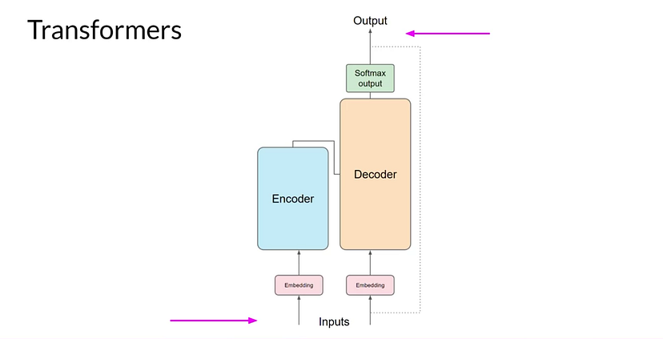
Architecture
Architectures evolve and diversify based on the specific AI image generation task, incorporating advancements.

Slide 11
Opportunities
Companies
Job & Career
Personal
Market

Slide 12
Interactive Poll
Which luxury fashion brand collaborated with an AI to create a new clothing collection in 2021?
Balenciaga
Gucci
Chanel
Louis Vuitton

Slide 13
Interactive Poll
Which luxury fashion brand collaborated with an AI to create a new clothing collection in 2021?
Balenciaga
Gucci
Chanel
Louis Vuitton

Slide 14
Company Opportunities
Video Games: AI-generated graphics, characters, and environments can enhance realism and gameplay experiences.
E-commerce Product Visualization: AI can generate high-quality product images and 3D visualizations for online stores.
Content Creation: AI can generate ad visuals, social media content, and marketing collateral at scale.
Virtual Fashion: AI-generated clothing designs and digital fashion shows are gaining popularity.

Slide 15
Job & Career Opportunities
Career Roles: Roles such as AI Image Generation Engineer, Computer Vision Specialist, or Data Scientist will see a boost.
Skills: Skills in programming like Python, TensorFlow, PyTorch, deep learning, image processing, and data analysis will be required more in the industry.
AI Startups: Entrepreneurs with innovative ideas for AI image generation applications can establish startups in this field, seeking to disrupt industries with creative solutions.
Freelance AI Artist or Designer: Freelancers with skills in AI image generation can offer their services to clients seeking custom visuals for various project

Slide 16
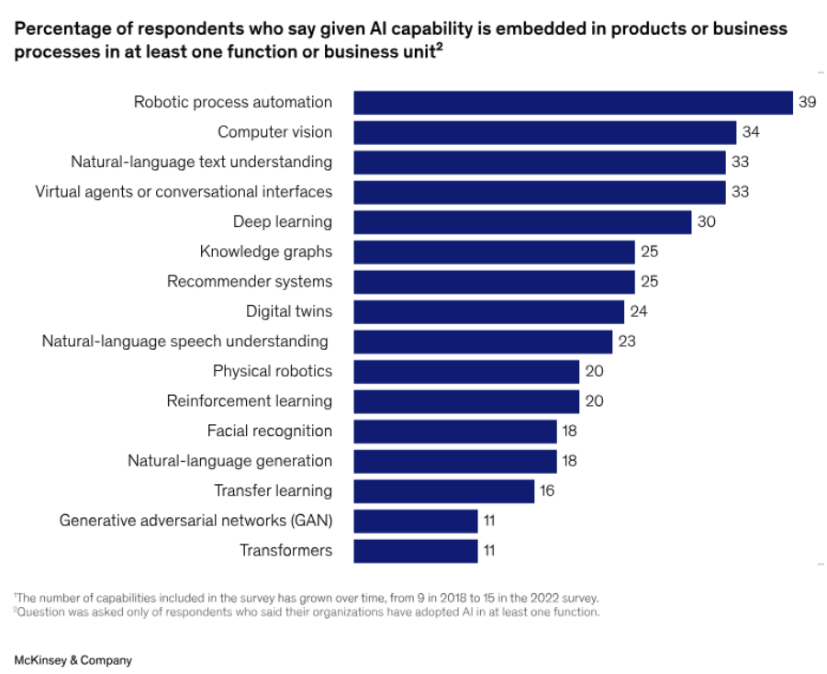
Job & Career Opportunities

Slide 17
Interactive Question
How would you use this in your daily life?

Slide 18
Personal Opportunities
Personal Projects: Use AI-generated images to enhance your personal projects.
Image Enhancement: Use AI tools to enhance and beautify personal photos, improving their quality, color, or style.
Personalized Content for Gifts: Custom AI-generated visuals can be created for gifts, cards, or personalized artwork for special occasions.
Creative Hobbies: Incorporate AI image generation into your creative hobbies, such as making posters, wallpapers, or digital collages.

Slide 19
Investment Opportunities
Market Potential: AI is the buzzword right now and the investors are ready to dive into this market given the products are feasible.
AI Art and NFTs: Investors interested in art and collectibles may explore opportunities to invest in AI-generated NFT art platforms and artists.
Content Creation: Platforms that offer AI-generated content for marketing, advertising, and social media campaigns are in demand. Investors can evaluate companies providing scalable solutions in this space.
Long-term Viability: Considering this is a relatively new field, this market should stay here for sometime.

Slide 20
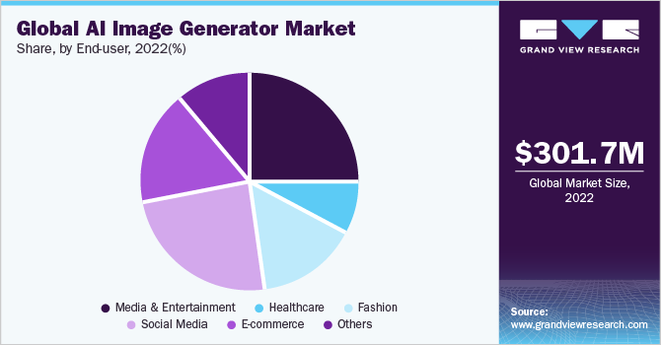
Investment Opportunities

Slide 21
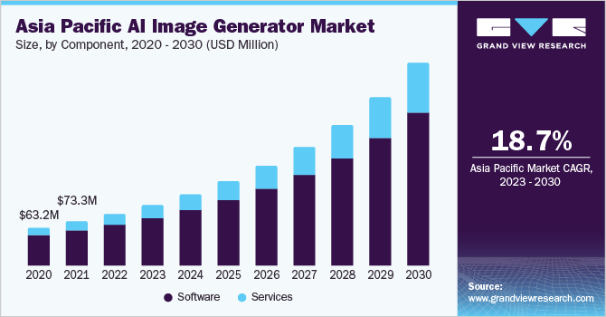
Investment Opportunities

Slide 22
Pros and Cons

Slide 23
Pros
Automation: It can automate the process of creating visual content, reducing the need for manual labor and speeding up production.
Cost-Efficiency: In some cases, AI-generated images can be more cost-effective than hiring human designers or photographers.
Accessibility: It can make creative content generation more accessible to individuals and businesses that may not have specialized design skills.
Speed: AI can generate images quickly, making it valuable for applications that require rapid content production,

Slide 24
Cons
Data Privacy: AI models used for image generation may require access to large datasets.
Dependency: Over reliance on AI for creative tasks can lead to a loss of human creativity.

Slide 25
Limitations
Lack of Originality: Since AI models learn from existing data, there is a risk that generated content may lack true originality.
Bias and Concerns: AI models can inherit biases from their training data.

Slide 26
Alternatives
Traditional Art and Design: Methods such as drawing, painting, and sculpture, have been used for centuries to create visual content. They provide artists with a high degree of creative freedom.
Photography: Photography is omnipresent and widely used method for capturing real-world scenes and objects.
Computer Graphics and 3D Modeling: They are essential in industries such as animation, video games, architecture, and product design. These techniques offer precise control over the virtual world.

Slide 27
Combined with other technologies
Virtual reality (VR): AI can be used to generate realistic VR environments that users can explore. This can be used for gaming, education, and training.
Augmented reality (AR): AI can be used to generate AR overlays that can be added to the real world. This can be used for navigation, advertising, and entertainment.
3D printing: AI can be used to generate 3D models that can then be printed. This could be used for prototyping, manufacturing, and medical applications.

Slide 28
Interactive Question
Which image generation tools have you used online ? Is any of them free?

Slide 29
Application
Scenarios

Slide 30
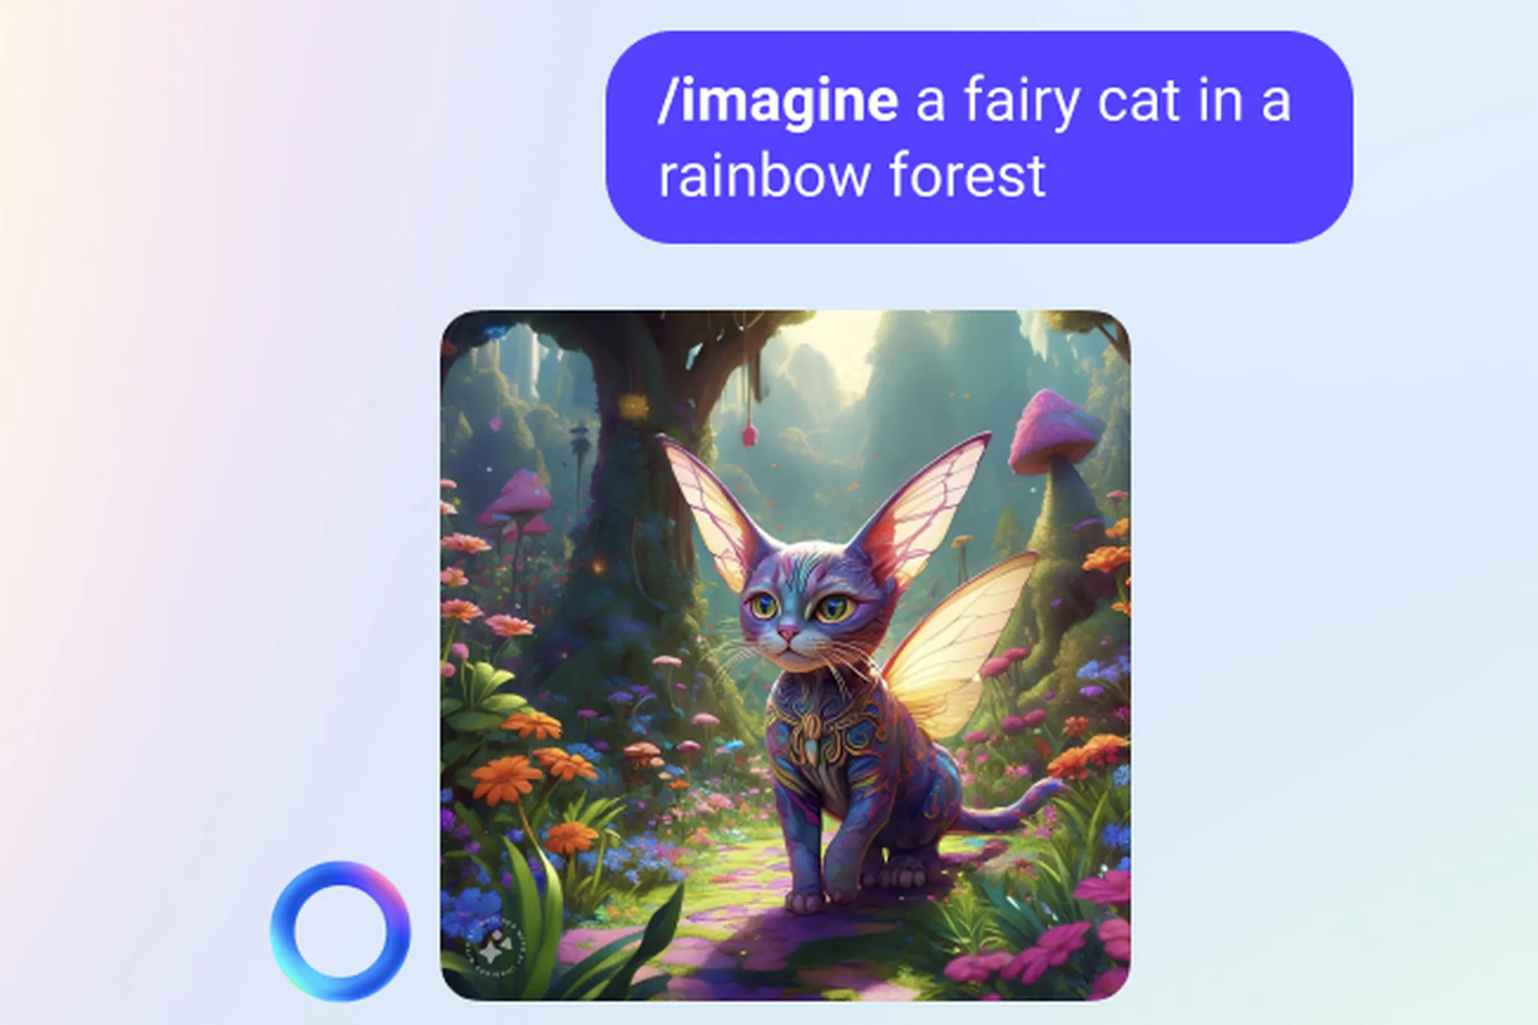
Current Use cases
API Integration : Synthesia Video Generation API, https://www.synthesia.io/
Meta : ( Free on WA, IG, FB )
https://www.theverge.com/2023/9/27/23891128/meta-ai-assistant-characters-whatsapp-instagram-connect
Adobe Firefly: https://www.youtube.com/watch?v=IVTyLYupECI&ab_channel=Adobe
Dall -E 3 Microsoft Bing

Slide 31
https://www.youtube.com/watch?v=IVTyLYupECI&ab_channel=Adobe

Slide 32
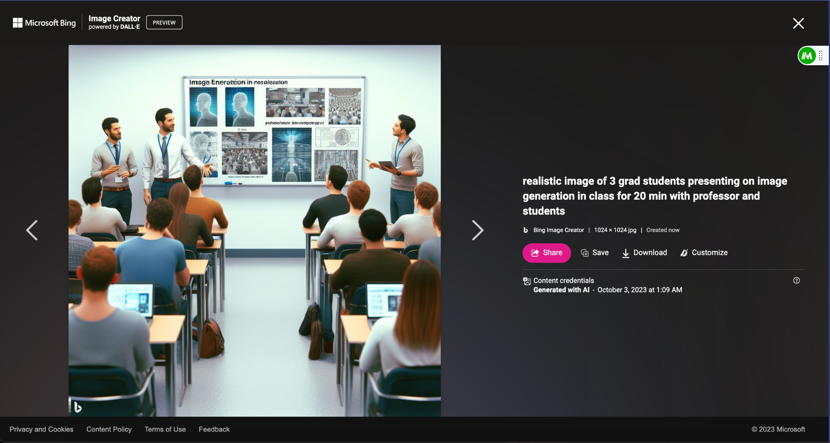

Slide 33
Future Use Case
AI image generation could be used to create new forms of art and entertainment, to develop new medical diagnostic tools, and to improve the design of products and services.
More creative and expressive AI image generators: AI image generators are still in their early stages of development, but they are already learning to create more creative and expressive images. In the future, we can expect to see AI image generators that can generate images in a variety of different artistic styles, and that can even understand and respond to human emotions.

Slide 34
Open Source Contributions
Open source contributions have played a major role in the development of image generation technology. Many of the most popular and advanced image generation models are open source. This has allowed researchers and developers to build on each other's work and to create new and innovative image generation models.
Examples:
The TensorFlow library from Google: TensorFlow is a free and open-source software library for numerical computation using data flow graphs. It is one of the most popular libraries used for machine learning and deep learning, including image generation.
The PyTorch library from Facebook: PyTorch is another free and open-source software library for machine learning and deep learning. It is also popular for image generation, and it is often used in conjunction with TensorFlow.
The Stable Diffusion model from Stability AI: Stable Diffusion is a state-of-the-art text-to-image diffusion model that is open source. It is able to generate high-quality images from text descriptions, and it is relatively easy to train and use.
The Imagen model from Google AI: Imagen is a text-to-image diffusion model that is still under development, but it has already shown impressive results. It is able to generate photorealistic images from text descriptions, and it is also able to generate images in a variety of different artistic styles.

Slide 35
Recommended Readings
Meta Assistants and Chat
https://www.theverge.com/2023/9/27/23891128/meta-ai-assistant-characters-whatsapp-instagram-connect
Dall-e
https://openai.com/research/dall-e

Slide 36
Discussion
Q & A

Slide 37
Thank You

